Slide 1

Copyright 2012 Davitily

Slide 2
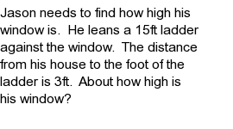
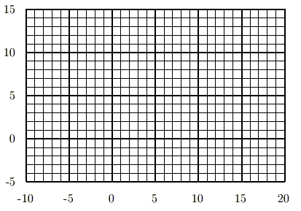
How to Solve a Pythagorean Word Problem II
Step 1:
Sketch the problem. Graph paper makes it even easier. Starting from the origin is usually the simplest way.
`
Step 1:
Sketch the problem.
Step 2:
Use the Pythagorean Theorem to solve.
Step 3:
Substitute and solve.
Window
15 ft
Step 2:
Use the Pythagorean theorem to solve. The hypotenuse is the distance from Jason to the window. That is the 'c' in the Pythagorean Theorem.
Hypotenuse
Step 3:
Substitute and solve.
Right Angle
House
Jason
3 ft

Slide 3
For more practice, visit
www.mathproblemgenerator.com

